Slide 1

Traveling Salesman Problem
By Susan Ott for 252

Slide 2
Overview of Presentation
Brief review of TSP
Examples of simple Heuristics
Better than Brute Force Algorithm

Slide 3
Traveling Salesman Problem
Given a complete, weighted graph on n nodes, find the least weight Hamiltonian cycle, a cycle that visits every node once.
Though this problem is easy enough to explain, it is very difficult to solve.
Finding all the Hamiltonian cycles of a graph takes exponential time. Therefore, TSP is in the class NP.

Slide 4
If the TSP is so hard, why bother?
The TSP is interesting because it is in
the class that is called NP-complete. If
the TSP is found to have an algorithm that
does not take exponential time, the other
problems that are NP-complete will also
be solved, and vice-a-versa.

Slide 5
If the TSP is so hard, why bother?
The TSP has quite a history.
-In the Odyssey by Homer, Ulysses has to
travel to 16 cities. 653,837,184,000 distinct
routes are possible.
-One of the first TSP papers was published in
the 1920s.

Slide 6
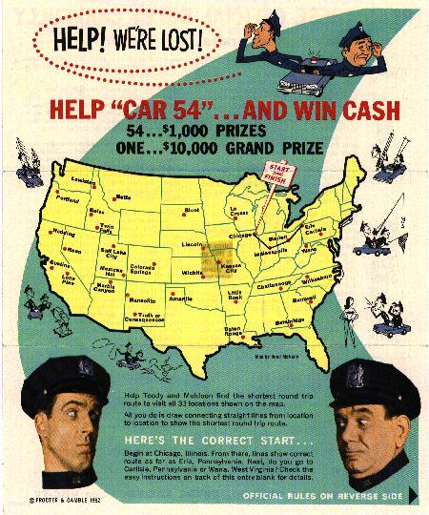
In 1962 a TSP contest was held.

Slide 7
If the TSP is so hard, why bother?
The TSP has many practical applications
-manufacturing
-plane routing
-telephone routing
-networks
-traveling salespeople
-structure of crystals

Slide 8
Is there any hope
for getting reasonable
solutions for the TSP?

Slide 9
What are Heuristics?
“Algorithms that construct feasible solutions, and thus upper bounds for the optimal value.”, Hoffman and Padberg

Slide 10
Insertion Heuristics
Insertion Heuristics start with a tour on
a small set of nodes, and then increase the
tour by inserting the remaining nodes one at a
time until there are n nodes in the tour
Cheapest
Farthest

Slide 11
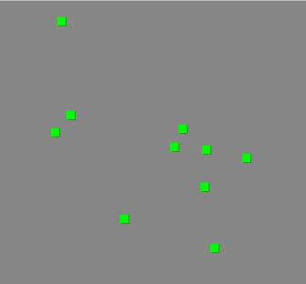
Cheapest and Farthest Insertion Heuristic
The verticies given

Slide 12
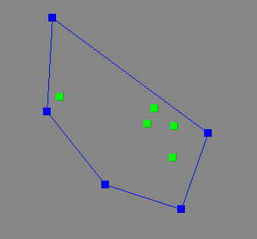
The Starting Tour is
the Tour that Follows the
Convex Hull

Slide 13
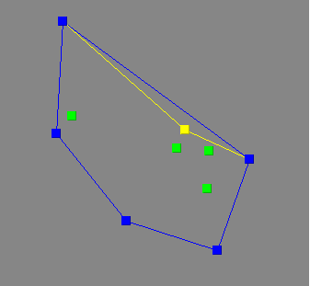
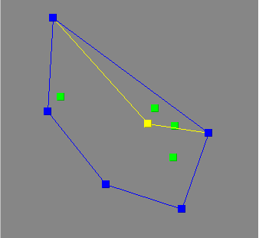
Cheapest
Farthest

Slide 14
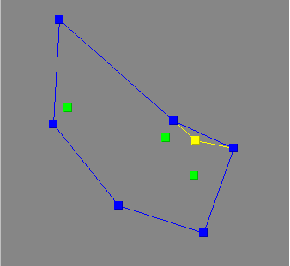
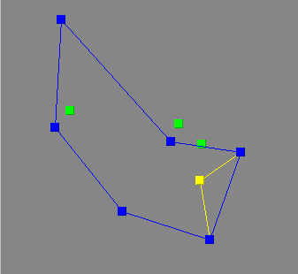
Cheapest
Farthest

Slide 15
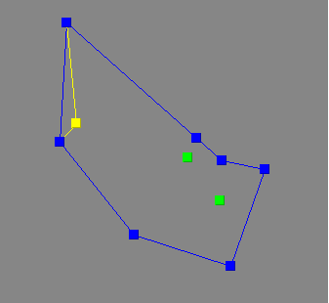
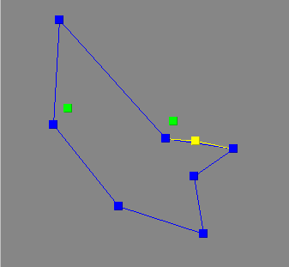
Cheapest
Farthest

Slide 16
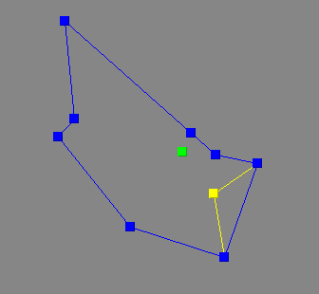
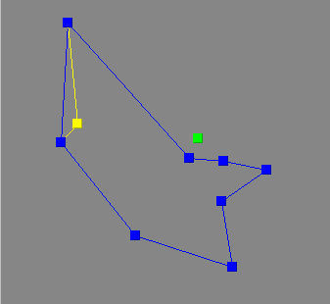
Cheapest
Farthest

Slide 17
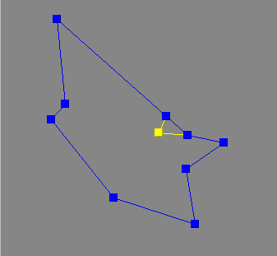
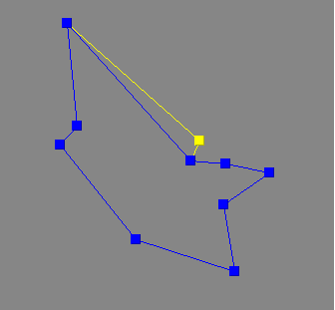
Cheapest
Farthest

Slide 18
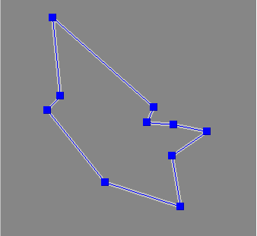
The optimal tour is
achieved in both cases!
Cheapest
Farthest

Slide 19
One of the good attributes of
these 2 heuristics is that they
avoid the possibility of edge-
crossing. The crossing of edges
guarantees that the solution is
not optimal.
There exists an algorithm that
removes all the edge-crossings in at
most n^3 time.

Slide 20
While good solutions may be
obtained using heuristics, it is
difficult to prove if those
solutions are optimal.
Perhaps there is a way that is
smarter than brute force that
gives the optimal solution.

Slide 21
Branch-and-Bound Algorithm
T(k) = a tour on k cities
Search(k,T(k-1))
if k=n
record the tour details
the bound B=length of the tour
else
Find the k-1 possibilities of adding
k to all of the possible places in the
tour
For every tour where the tour length is
less then B, Search(k+1,T(k))

Slide 22
In 1993 Bixby, Applegate,
Chvatal, and Cook found a
solution for 3,038 cities using
the Branch-and-Bound technique,
a world record at the time!
The computations were done on
50 SGI workstations, and took
a year and a half.

Slide 23
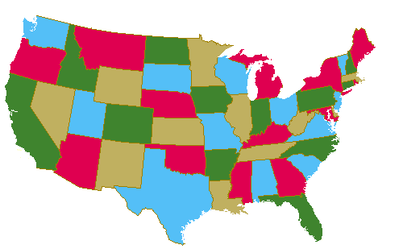
6 Cities using Branch-and-Bound
Boston
Seattle
Denver
San Diego
Santa Fe
New Orleans

Slide 24
Here is a pretty good tour we could use for our bound.
Boston
Seattle
Denver
San Diego
Santa Fe
New Orleans

Slide 25
This Tour has a length of 8,972 miles.
We assign this value to the bound B.
Boston
Seattle
Denver
San Diego
Santa Fe
New Orleans

Slide 26
Start of with your first 3 cities. The tour length here is 6,063 miles. Ok so far!
Boston
Denver
San Diego
Bound B=8,972 miles

Slide 27
Now we try out the 3 different ways to add New Orleans to the tour.
Boston
Denver
San Diego
New Orleans
Bound B=8,972 miles

Slide 28
Trial 1: 8,113.6 miles. Less then or equal to the bound, so we will not terminate it.
Boston
Denver
San Diego
New Orleans
Bound B=8,972 miles

Slide 29
Trial 2: 6,308.2 miles. Less then or equal to the bound, so we will not terminate it.
Boston
Denver
San Diego
New Orleans
Bound B=8,972 miles

Slide 30
Trial 3: 6,921.6 miles. Less then or equal to the bound, so we will not terminate it.
Boston
Denver
San Diego
New Orleans
Bound B=8,972 miles

Slide 31
Now adding Seattle, modify Trial 1.
Seattle
Boston
Denver
San Diego
New Orleans
Bound B=8,972 miles

Slide 32
Trial 1a: 10,776.4 miles, over the bound so we will not pursue it.
Seattle
Boston
Denver
San Diego
New Orleans
Bound B=8,972 miles

Slide 33
Trial 1b has a tour length of 10,200.6 miles, more then the bound.
Seattle
Boston
Denver
San Diego
New Orleans
Bound B=8,972 miles

Slide 34
Trial 1c has a tour length of 9,401.3 miles, more than the bound.
Seattle
Boston
Denver
San Diego
New Orleans
Bound B=8,972 miles

Slide 35
Trial 1d has a tour length of 10,518.5 miles, more than the bound again.
Seattle
Boston
Denver
San Diego
New Orleans
Bound B=8,972 miles

Slide 36
Since all of these branches off of trial one are already more than the bound, we will not pursue them since adding another city will only increase the tour length!
Now lets see what happens in trial 2.

Slide 37
Trial 2a:7,888.2 miles. Less then the bound!
Seattle
Boston
Denver
San Diego
New Orleans
Bound B=8,972 miles

Slide 38
Trial 2b: 8,467 miles. Less than the bound.
Seattle
Boston
Denver
San Diego
New Orleans
Bound B=8,972 miles

Slide 39
Trial 2c:10,556.1 miles.
More than the bound. Consider it terminated.
Seattle
Boston
Denver
San Diego
New Orleans
Bound B=8,972 miles

Slide 40
Trial 2d: 8,785.1 miles, and under the bound.
Seattle
Boston
Denver
San Diego
New Orleans
Bound B=8,972 miles

Slide 41
So from trial 2 we will move on with 2a, 2b, and 2d.
First, though, lets check out 3a, 3b, 3c, and 3d.

Slide 42
Trial 3a: 8,429.6 miles. Less then the bound!
Seattle
Boston
Denver
San Diego
New Orleans
Bound B=8,972 miles

Slide 43
Trial 3b: 8,209.3 miles. Less then the bound!
Seattle
Boston
Denver
San Diego
New Orleans
Bound B=8,972 miles

Slide 44
Trial 3c: 11,097.5 miles. More than the bound!
Seattle
Boston
Denver
San Diego
New Orleans
Bound B=8,972 miles

Slide 45
Trial 3d: 9,584 miles. More than the bound!
Seattle
Boston
Denver
San Diego
New Orleans
Bound B=8,972 miles

Slide 46
Now we have 2a, 2b,
2d, 3a, and 3b left as
tours less than
the bound.
I could draw a map for all of these,
but instead I will just give the
values of their tours.

Slide 47
2a (7,888.2) -> 8415.1
8972.4
*8106.6*
9727
8504.2
2b (8,467.2)
2d (8,785.1)
3a (8,429.6)
3b (8,209.3)
since 2a gave a full tour of length 8,106.6 miles,
and this tour is less than 2b, 2d, 3a, and 3b we
know that 8,106.6 miles is the answer, and we
need not look at the results that 2b, 2d, 3a, and
3b give.

Slide 48
The optimal solution!
Tour length =8,106.6, a branch off of tour 1b.
Boston
Seattle
Denver
San Diego
Santa Fe
New Orleans

Slide 49
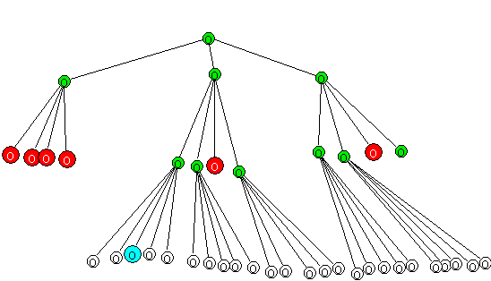
The green nodes
are the tours
that are less than
the bound. The red
nodes are the tours
that exceed the bound

Slide 50
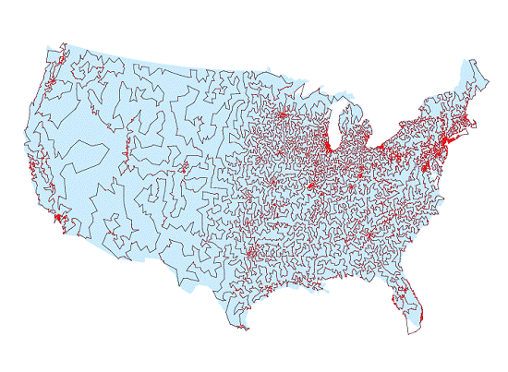
The same researchers went on
to find the optimal path for 13,509
cities in 1998!

Slide 51
Summary
-The TSP is in the class NP
-The TSP has good applications
-There are good ways of
approximating solutions for TSP
-There are smarter ways of
solving the TSP than brute-force

Slide 52
Contribution
-Web Research
-Branch and Bound Experiment
on the 6 cities
-Understanding Branch and Bound

Slide 53
References
http://iris.gmu.edu/~khoffman/papers/trav_salesman.html
http://www.densis.fee.unicamp.br/~moscato/TSPBIB_home.html
http://riceinfo.rice.edu/projects/reno/m/19980625/tsp.html
http://www.pcug.org.au/dakin/tspbb.htm
The Traveling Salesman Problem Edited by Lawler, Lenstra, Rinnoy Kan, Shmoys

